Slide 1

C++ PROGRAMMING
DAY 5
By SHIVAM GUPTA

Slide 2

About Me
I am Frontend Web Developer and open source enthusiast.
Mentor at STUDENT CODE-IN.
Connect with me here:
LinkedIn: https://www.linkedin.com/in/shivamgupta57121/
GitHub: https://github.com/shivamgupta57121
Twitter: https://twitter.com/ShivamG57121

Slide 3
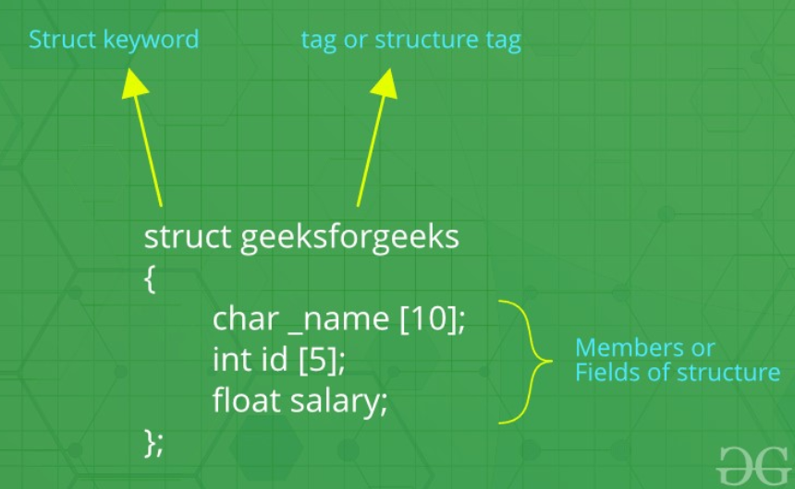
Structures in C++
User defined data types
Used to store group of items of non-similar data types.

Slide 4
Members in Structure
Structures in C++ contains two types of members:
Data Member: variables
Member Functions: functions
// Data Members
int name;
int age;
// Member Functions
void printDetails()
{
cout<<"Name = "<<name<<endl;
cout<<"Age = "<<age<<endl;
}

Slide 5
How to declare structure variables?
struct Point
{
int x, y;
} p1;
int main()
{
struct Point p2;
}

Slide 6
Initialize structure members
struct Point
{
int x, y;
};
int main()
{
struct Point p1 = {0, 1};
}

Slide 7
Access structure members
We can access the members of the structure using dot(.) operator.
For Example:
#include <iostream>
using namespace std;
struct Point {
int x, y;
};
int main()
{
struct Point p1 = { 0, 1 };
// Accessing members of point p1
p1.x = 20;
cout << "x = " << p1.x << ", y = " << p1.y;
return 0;
}

Slide 8
Array of structures
We can create an array of structure variables.
#include <iostream>
using namespace std;
struct Point {
int x, y;
};
int main()
{
// Create an array of structures
struct Point arr[10];
// Access array members
arr[0].x = 10;
arr[0].y = 20;
cout << arr[0].x << " " << arr[0].y;
return 0;
}

Slide 9
Object Oriented Programming
It is about creating objects that contain both data and functions.
Features of OOP : Data Abstraction, Encapsulation, Inheritance, Polymorphism.
Advantages of OOP over Procedural Programming:
Data is secured
OOP provides a clear structure for the programs
OOP makes it possible to create full reusable applications with less code and shorter development time

Slide 10
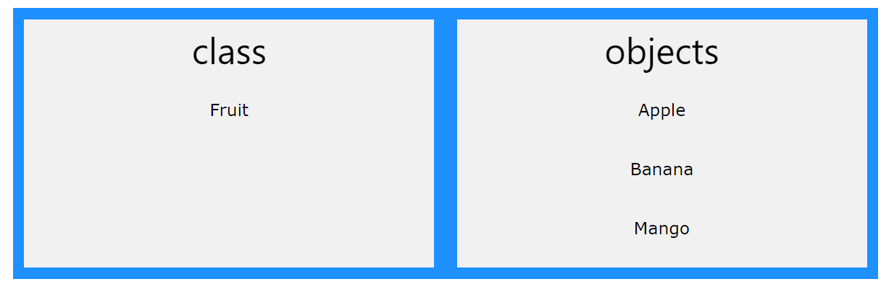
Classes and Objects
Object : It is a real world entity having characteristics(data members) and behaviour (functions)
Class : User defined data type which is a template for objects.

Slide 11
Create a Class and objects.
// Create a Car class with some attributes class Car { public: string brand; string model; int year; }; int main() { // Create an object of Car Car carObj1; carObj1.brand = "BMW"; carObj1.model = "X5"; carObj1.year = 1999;
// Create another object of Car Car carObj2; carObj2.brand = "Ford"; carObj2.model = "Mustang"; carObj2.year = 1969; // Print attribute values cout << carObj1.brand << " " << carObj1.model << " " << carObj1.year << "\n"; cout << carObj2.brand << " " << carObj2.model << " " << carObj2.year << "\n"; return 0; }

Slide 12
Class Methods
Outside class definition
class MyClass { // The class public: // Access specifier void myMethod(); // Method/function declaration }; // Method/function definition outside the class void MyClass::myMethod() { cout << "Hello World!"; } int main() { MyClass myObj; // Create an object of MyClass myObj.myMethod(); // Call the method return 0; }
Inside class definition
class MyClass { // The class
public: // Access specifier
void myMethod() {
cout << "Hello World!";
}
};
int main() {
MyClass myObj; // Create an object of MyClass
myObj.myMethod(); // Call the method
return 0;
}

Slide 13
Constructors
For Example :
class MyClass { public: MyClass() { // Constructor cout << "Hello World!"; } }; int main() { MyClass myObj; return 0; }
A constructor in C++ is a special method that is automatically called when an object of a class is created.
Same name as that of class.
There are many types of constructor like default constructor, constructor with parameters, copy constructor.
In copy constructor we need to pass object as a parameters.

Slide 14
Access Specifiers
Access specifiers define how the members (attributes and methods) of a class can be accessed.
In C++, there are three access specifiers:
public - members are accessible from outside the class
private - members cannot be accessed (or viewed) from outside the class
protected - members cannot be accessed from outside the class, however, they can be accessed in inherited classes.

